Slide 1
Data analysis with R & RStudio
Week 6 – correlation and regression
Tomáš Diviák
tomas.diviak@manchester.ac.uk

Slide 2
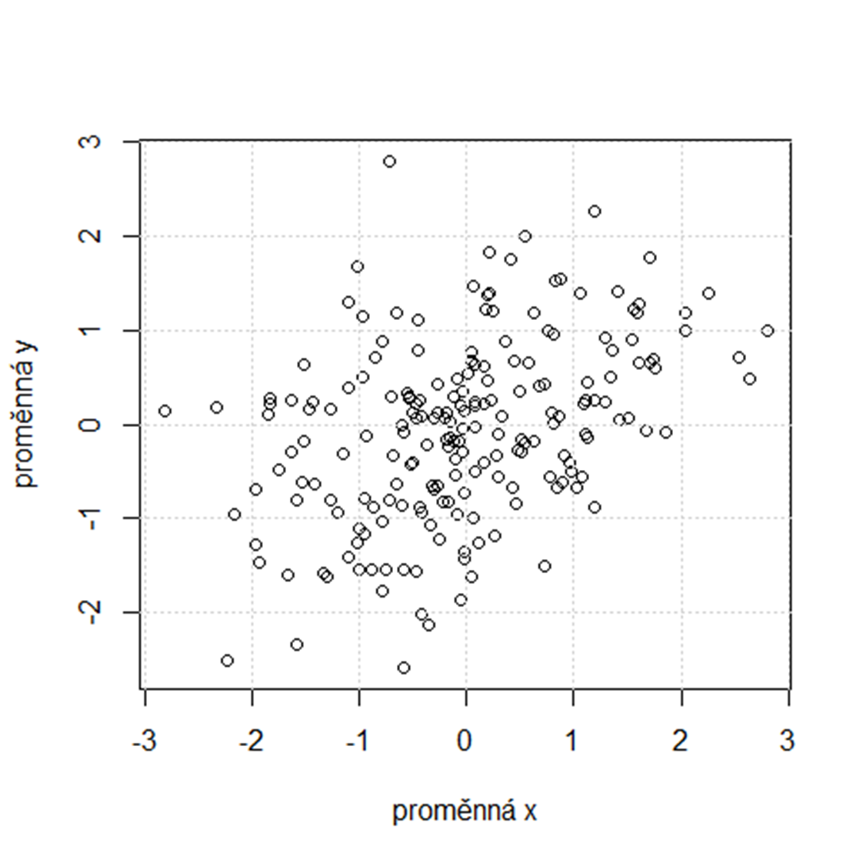
Notes:
Scatterplot – vysvětlit
Je tam vztah nebo není? Co to znamená? Že s nárůstem jedné proměnné narůstá/klesá druhá (srov. Ne/přímá úměrnost)

Slide 3
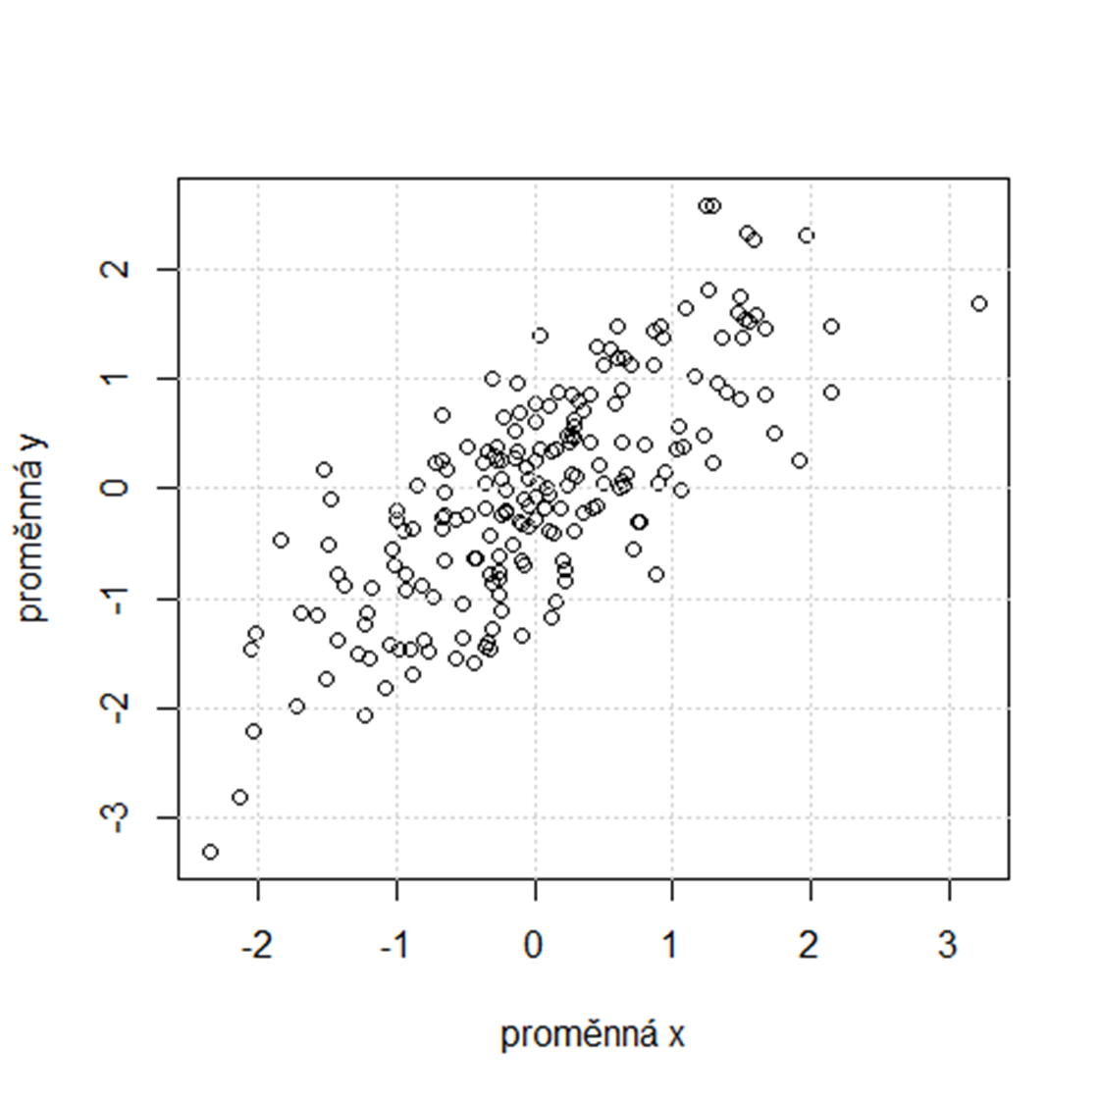
Notes:
A co teď?
Klíčová myšlenka -> statistický vztah je něco mezi úplnou náhodou a úplným determinismem (např. s nárůstem X narůstá Y, ale ne lineárně a stejnoměrně)

Slide 4
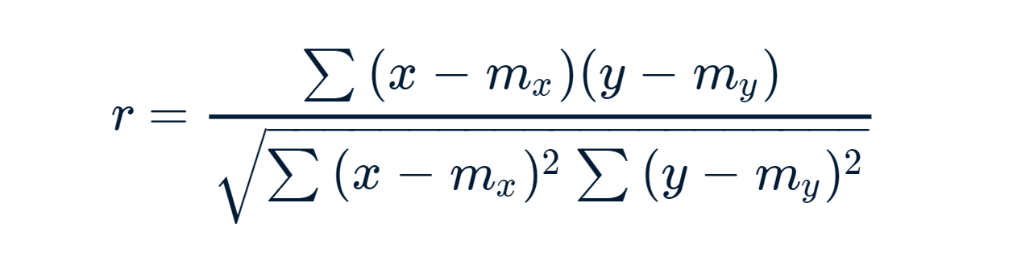
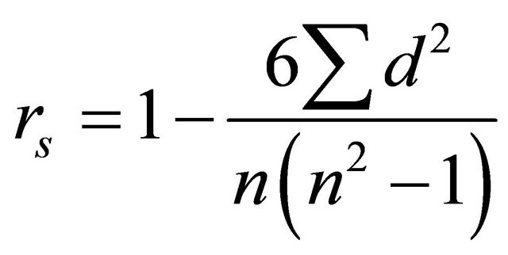
Correlation
Association between two numeric variables
Correlation coefficients: range <-1; 1>
  Pearson‘s product-moment correlation c. – linear relationships
  Spearman‘s ρ – for ranks
  Kendall‘s τ – for ranks
  Interpretation:
    0.0 – 0.2 / 0.3 – weak
    Around 0.5 – moderate
    > 0.8 – strong
    →only indicative, better to consult previous research in a given field!

Slide 5
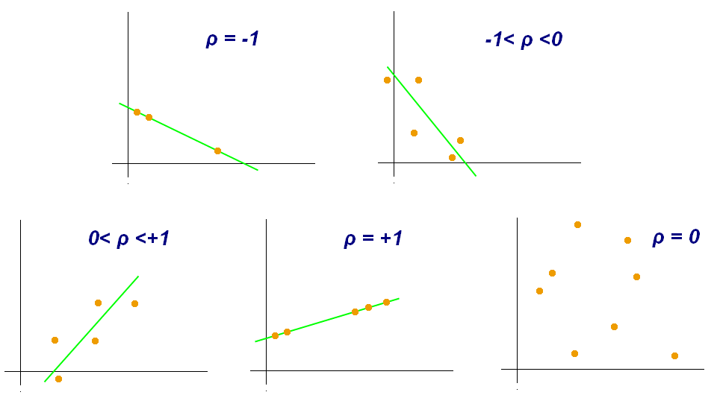

Slide 6
Correlation and causation
CORRELATION DOES NOT IMPLY CAUSATION!!!
Correlation is necessary, but not sufficient for causal claims
  Temporal ordering – A needs to always precede B in order to establish causality
  No effect of confounding variables – the relationship between A and B should be adjusted for any potential confounding variable
Causal claims thus require a good theory (causal mechanism), good methods (ideally experiments), and a lot of research to be backed up
Example: fertility and stork population

Slide 7
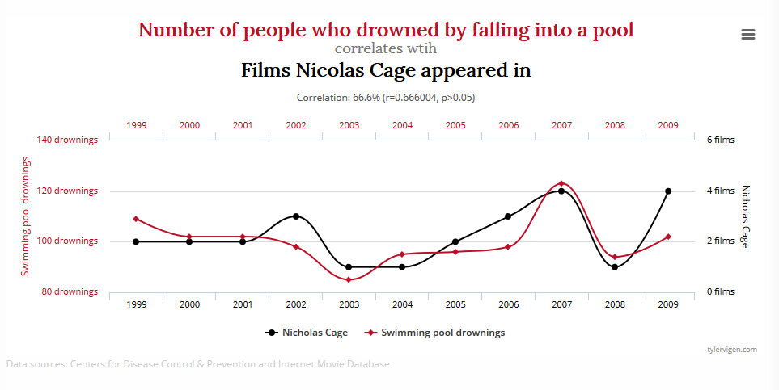
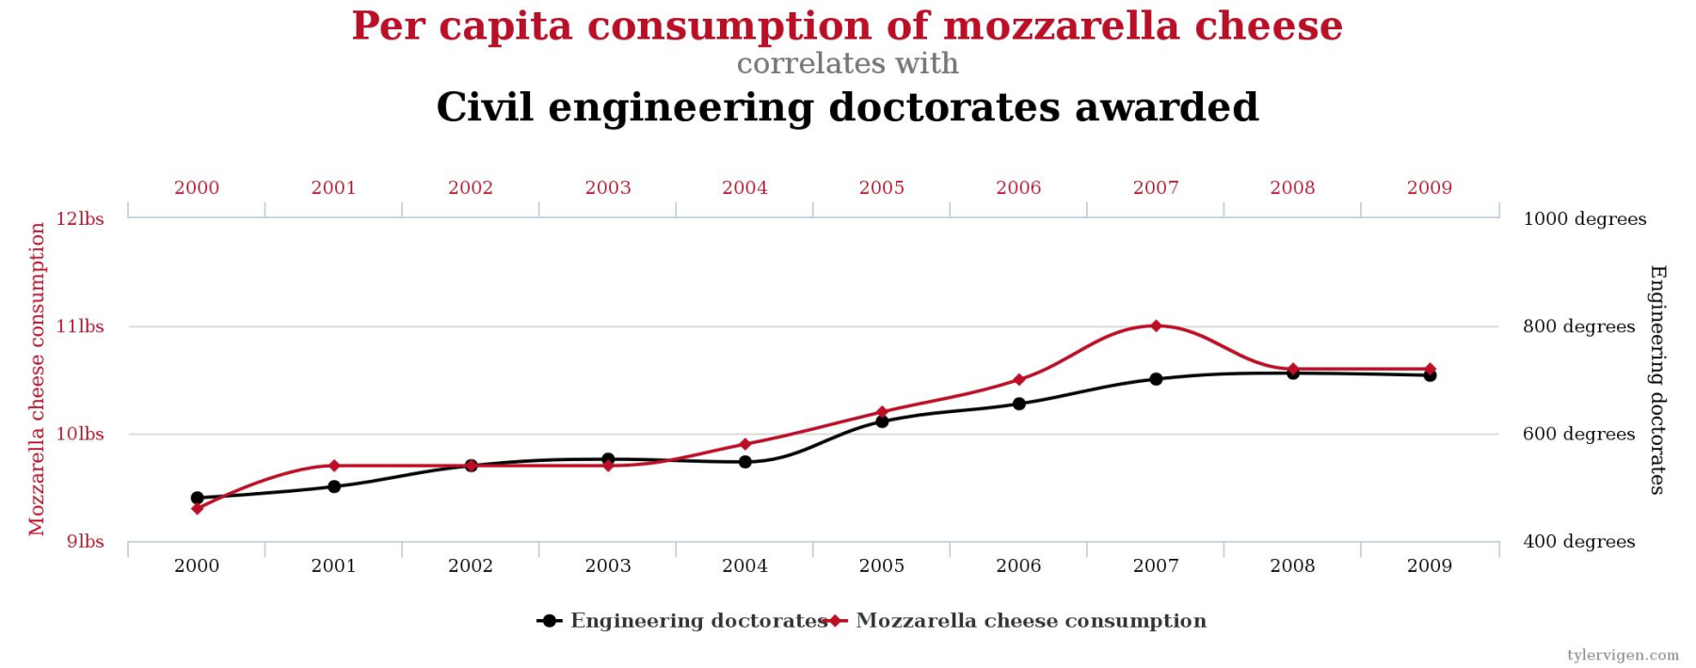

Slide 8
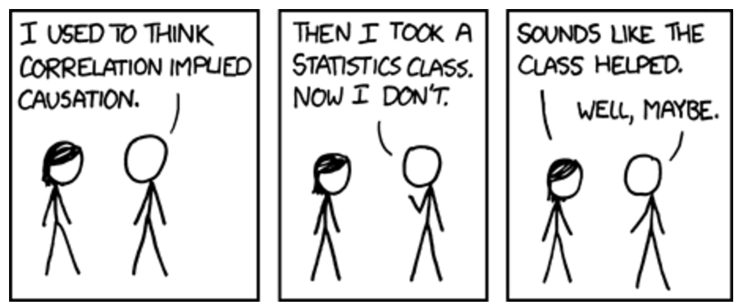

Slide 9
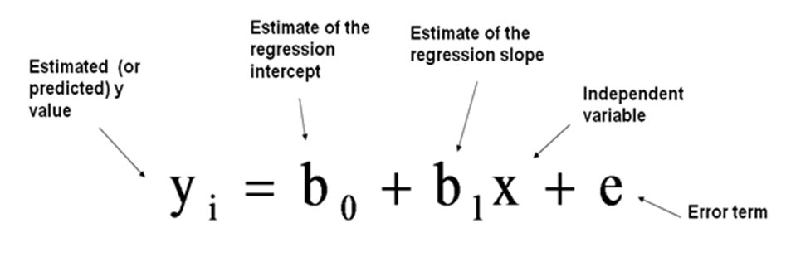
Linear regression
Predicting values of a numeric variable from values of another
Outcome = predictor(s) + error (or dependent variable = independent variable(s) + error)
* error = some residual random fluctuation → we simplify from the world, which inherently comes with some error
Linear regression – continuous outcome (y) = average (b₀) + (b₁x) continuous predictor (e.g., income = baseline + years of education)

Slide 10
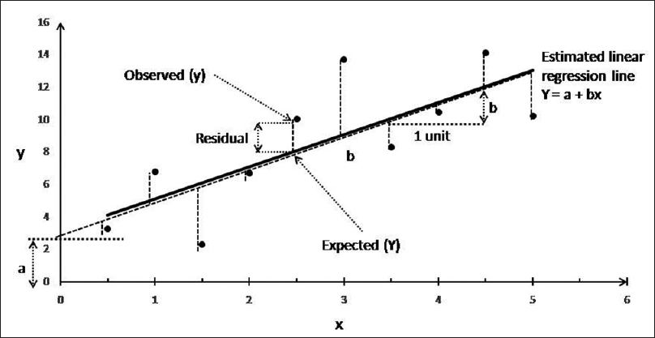

Slide 11
Linear regression
Regression line aims to capture the variability in the data in the best way possible → the method of ordinary least squares (OLS). The OLS finds a line that has the minimal sum of squared distances from the data points of all the possible lines.
Regression line defined by Y_{i}= B₀ + B₁x_{i} + e_{i}
  Intercept B₀ - the point in which the line intersects with the Y axis → the predicted value of Y if X = 0
  Slope B₁ - may be positive or negative, a value by which Y increases/decreases when we increase X by 1 unit
Squared distance of a data point from its prediction = residual (an error of prediction essentially)
Coefficient of determination (R²) = proportion of the variability explained by the model the overall variability in the dependent variable (the more, the better the model, range <0; 1>)

Slide 12
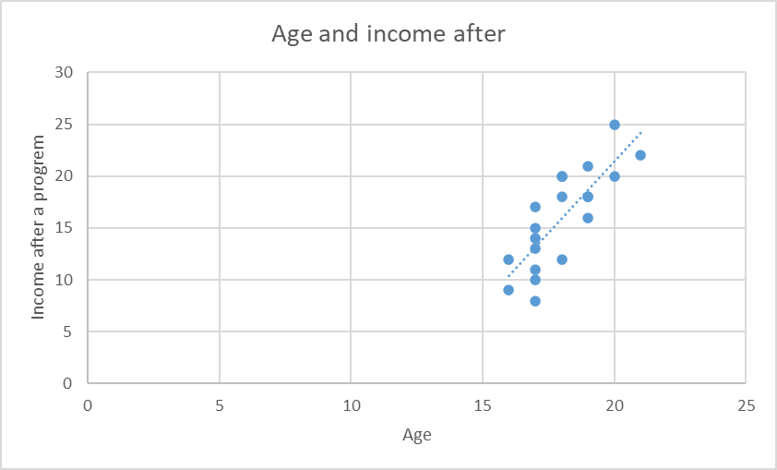

Intercept B₀ | Slope B₁
-33.55 | 2.75
Correlation
0.8
What would be the income of a 29-years old person? →
Income after = B₀ + B₁ * age →
46.2 (income after) = -33.55 + 2.75 * 29 (age)

Slide 13
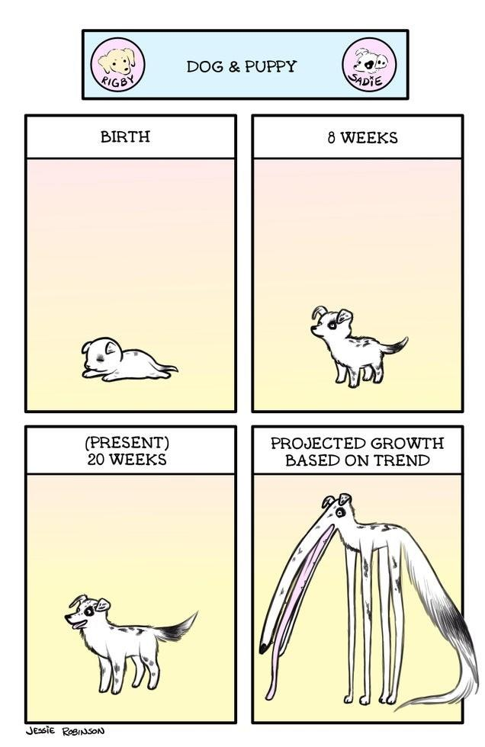

Slide 14

Thanks for your attention ☺
Questions?

